Slide 1

SERIAL PERIPHERAL INTERFACE(SPI)
Presented by Giresh,Lokesh
Chipweave Technologies Pvt Ltd

Slide 2

INTRODUCTION TO SPI
SPI supports half-duplex and full-duplex serial communication.
It is a synchronous communication protocol (clock is provided along with data).
SPI is a four-wire communication protocol.
In most cases, SPI uses a single master and multiple slave configuration, but it also supports multiple master configurations.
SPI is an on-board, short-range communication protocol used in embedded systems.
It supports high-speed data transfer, typically up to 10 Mbps.
The master provides the clock for synchronization.
SPI supports 8-bit and 16-bit data frame formats.

Slide 3
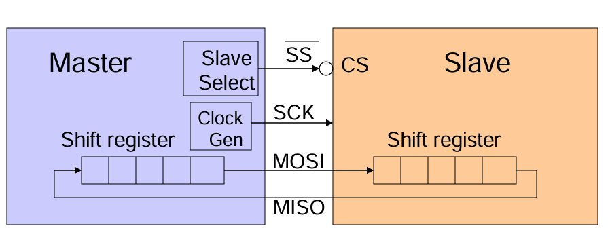
SPI CONNECTIONS
SCLK – serial clock, generated by the master
MOSI –master output/slave input
MISO –master input/slave output
SS – slave select/enable signal

Slide 4
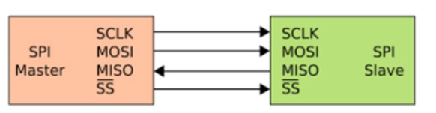
WORKING
Master selects the slave
The master pulls SS (Slave Select) LOW to choose the slave device.
Master generates the clock
The master provides SCLK, which synchronizes data transfer between master and slave.
Data transfer happens on clock edges
Data is sent from Master to Slave on MOSI and from Slave to Master on MISO, based on clock edges (CPOL/CPHA).
Communication ends by releasing SS
After data transfer, the master sets SS HIGH, ending the SPI communication.

Slide 5
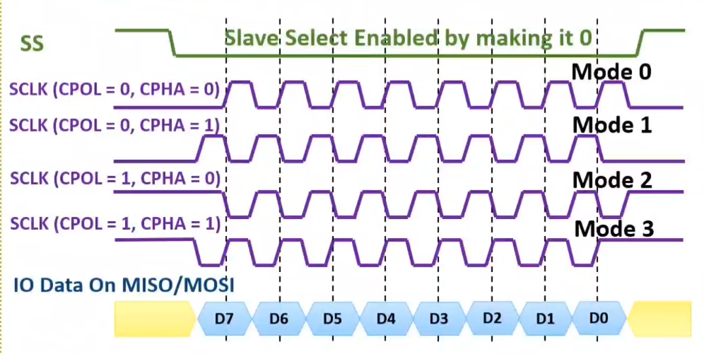
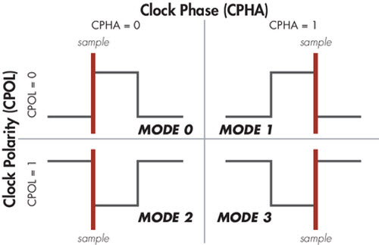
CPOL & CPHA TIMING DIAGRAM

Slide 6
SPI MODES OF OPERATION
1.Run Mode (Normal Mode)
SPI works normally
Clock is ON
Data transmission and reception occur as usual
Used during regular operation
2. Wait Mode (Low-Power but Smart Mode)
Wait mode behavior depends on SPISWAI bit.
If SPISWAI = 0, SPI behaves exactly like Run Mode, No power saving.
If SPISWAI = 1, SPI clock generation is turned OFF to save power.
Master Mode
Ongoing transmission pauses
Transmission resumes when CPU returns to Run Mode
Slave Mode
SPI continues receiving and transmitting
This keeps the slave synchronized with the master

Slide 7
SPI MODES OF OPERATION
3.Stop Mode (Deep Sleep Mode)
Maximum power saving
Master: Transmission stops, resumes in Run Mode
Slave: Completes current byte and maintains synchronization

Slide 8
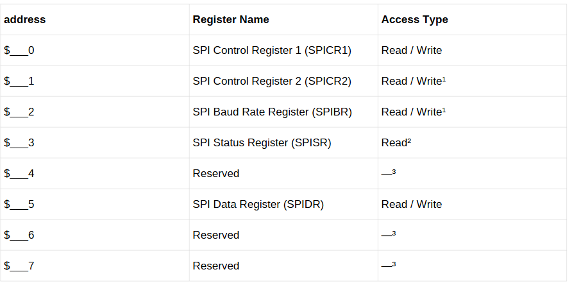
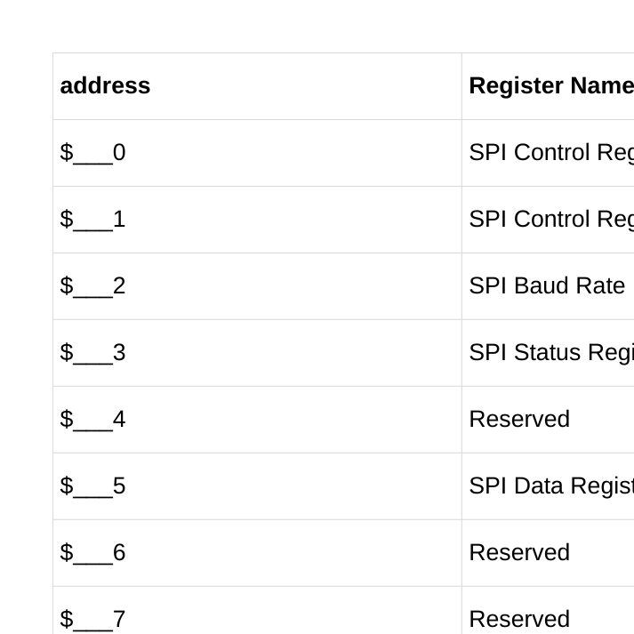
MEMORY MAP/REGISTER DEFINITION
This section describes the address space and registers used by the SPI module.

Slide 9
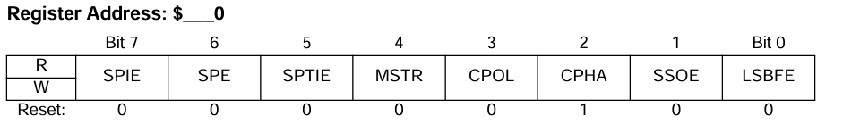
SPI CONTROL REGISTER 1
SPE – SPI System Enable
Turns the SPI module ON or OFF
Assigns SPI function to port pins
Values:
1 → SPI enabled, pins used for SPI
0 → SPI disabled, low power, idle state
SPIE – SPI Interrupt Enable
Enables SPI interrupts
Interrupt occurs when:
SPIF (receive complete) OR
MODF (mode fault) is set
Values:
1 → SPI interrupts enabled
0 → SPI interrupts disabled

Slide 10
SPTIE – SPI Transmit Interrupt Enable
Enables interrupt when transmit buffer is empty (SPTEF)
Values:
1 → SPTEF interrupt enabled
0 → SPTEF interrupt disabled
MSTR – Master / Slave Select
Selects SPI operating mode
Values:
1 → Master mode
0 → Slave mode

Slide 11
CPOL – SPI Clock Polarity
Selects the idle level of SPI clock (SCK)
Master and Slave must use the same CPOL
Changing CPOL during transmission aborts transfer
Values:
CPOL = 0
Clock idle = LOW
Active-high clock
CPOL = 1
Clock idle = HIGH
Active-low clock
CPHA – SPI Clock Phase
Selects when data is sampled
Master and Slave must use the same CPHA
Changing CPHA during transmission aborts transfer
Values:
CPHA = 0
Data sampled on first (odd) clock edge
CPHA = 1
Data sampled on second (even) clock edge

Slide 12
SSOE (SS Output Enable)
Decides whether master drives SS or not
MODFEN = 0 (Mode-fault disabled)
SSOE Meaning
0 SPI does not use SS
1 SPI still does not use SS
MODFEN = 1 (Mode-fault enabled)
SSOE Meaning
0 SS is input (used for fault detection)
1 SS is output (master drives SS)

Slide 13
LSBFE — LSB-First Enable
Controls the bit transmission order in SPI communication
Operation
LSBFE = 1
Data is transferred Least Significant Bit (LSB) first
LSBFE = 0
Data is transferred Most Significant Bit (MSB) first

Slide 14
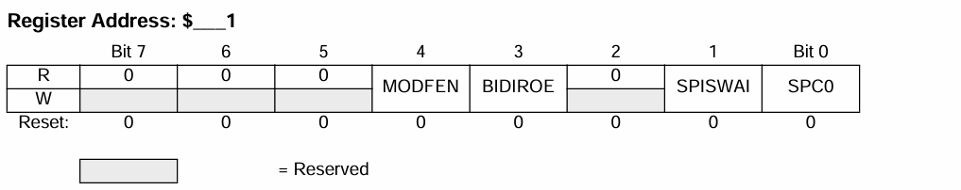
SPI CONTROL REGISTER 2
MODFEN — Mode Fault Enable Bit
Enables detection of Mode Fault (MODF) errors in SPI
Controls how the SS (Slave Select) pin is used by the SPI module
Operation
MODFEN = 1
SS port pin is enabled with Mode Fault (MODF) detection
MODFEN = 0
SS port pin is not used by the SPI

Slide 15
SPI CONTROL REGISTER 2
BIDIROE — Bidirectional Output Enable
Controls the output buffer in bidirectional SPI mode
Applicable only when bidirectional mode is enabled (SPC0 = 1)
Operation
BIDIROE = 1
Output buffer is enabled
BIDIROE = 0
Output buffer is disabled

Slide 16
SPI CONTROL REGISTER 2
SPISWAI — SPI Stop in Wait Mode
Used for power conservation when the CPU enters Wait Mode
Controls whether the SPI clock runs or stops in Wait Mode
Operation
SPISWAI = 1
SPI clock generation is stopped in Wait Mode
Helps reduce power consumption
SPISWAI = 0
SPI clock operates normally in Wait Mode
No power saving

Slide 17
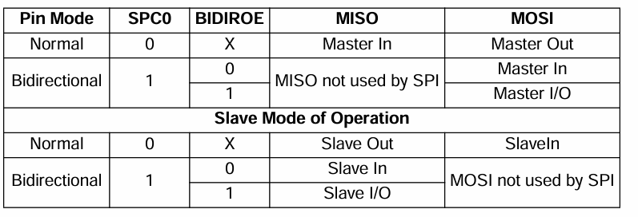
SPI CONTROL REGISTER 2
SPC0 decides how many data pins SPI uses.
SPC0 = 0 → Normal SPI mode
SPC0 = 1 → Bidirectional SPI mode

Slide 18
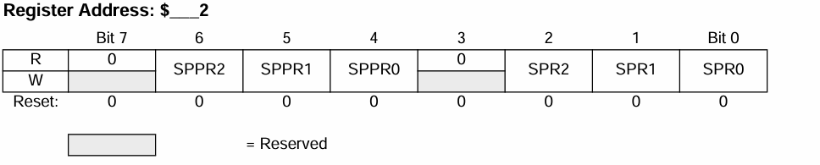
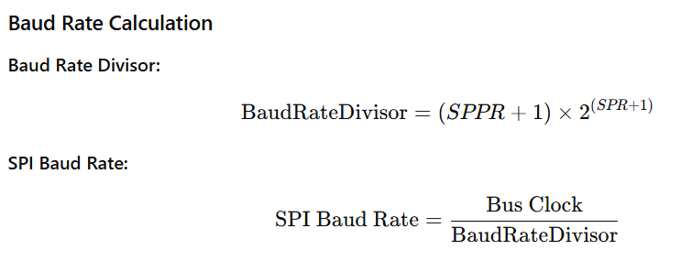
SPI BAUD RATE REGISTER
Baud rate is determined by preselection bits (SPPR) and selection bits (SPR)
Applicable only in Master Mode
Bit Function
SPPR2–SPPR0
Baud Rate Preselection bits
SPR2–SPR0
Baud Rate Selection bits

Slide 19
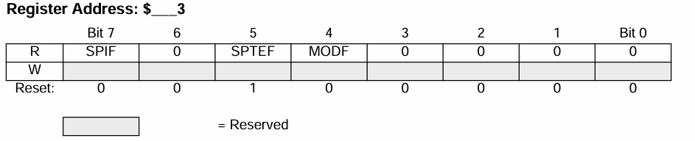
SPI STATUS REGISTER
SPIF — SPI Interrupt Flag
Indicates completion of a data transfer
Set when a received data byte is copied into the SPI Data Register (SPIDR)
Operation
SPIF = 1
New data has been successfully received
Data is available in SPIDR
SPIF = 0
Data transfer is not yet complete

Slide 20
SPI STATUS REGISTER
SPTEF — SPI Transmit Empty Interrupt Flag
Indicates the status of the SPI transmit data register
Used to control safe data transmission
Operation
SPTEF = 1
SPI Data Register is empty
New data can be written to SPIDR
SPTEF = 0
SPI Data Register is not empty
Write operation is not allowed

Slide 21
SPI STATUS REGISTER
MODF — Mode Fault Flag
Indicates a mode fault condition in SPI operation
Applicable when SPI is configured in Master Mode
Operation
MODF = 1
Mode fault has occurred
MODF = 0
No mode fault detected

Slide 22
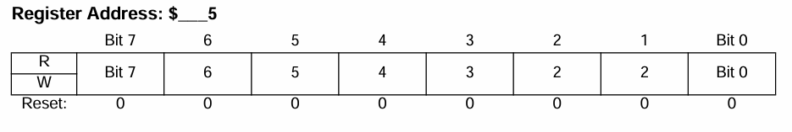
SPI DATA REGISTER
Single Data Register
SPIDR acts as both input and output register for SPI data.
Transmit Operation
Writing to SPIDR queues one data byte for transmission.
In Master mode, transmission starts immediately after the previous transfer completes.
Transmit Ready Indication
SPTEF flag in SPISR indicates when SPIDR is ready to accept new data.
Receive Operation
Received data can be read after SPIF is set and before the next transfer ends.
Data Loss Condition
If SPIF is not serviced before the next transfers complete,
new data bytes are lost, and SPIDR retains only the first unread byte.

Slide 23
THANK YOU

